Slide 1
Lecture 7
Recap
Introduction to Classical Gaussian Process Regression
Quantum Enhanced GP Modelling

Slide 2
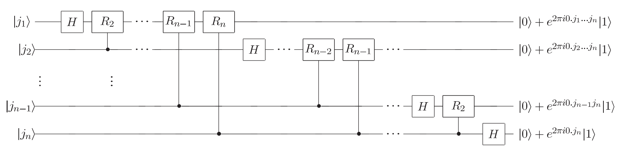
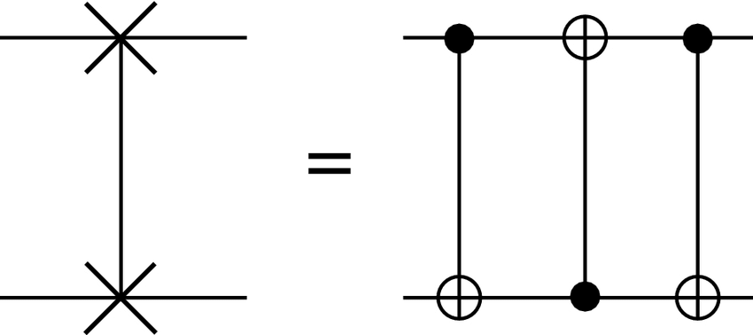
Recap: QFT

Slide 3
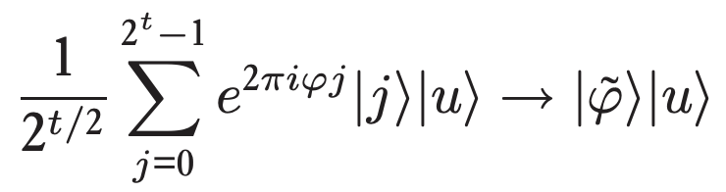
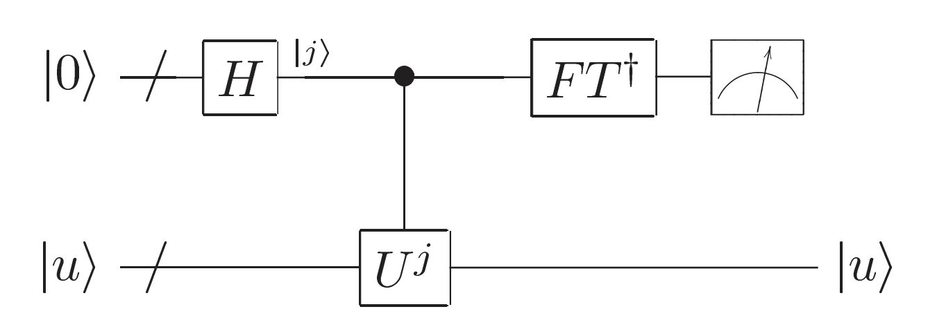
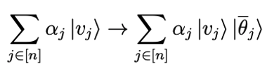
Recap: QPE – inverse QFT for completion
First register
Second register

Slide 4
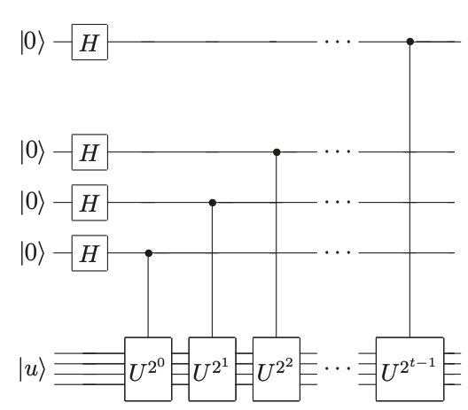
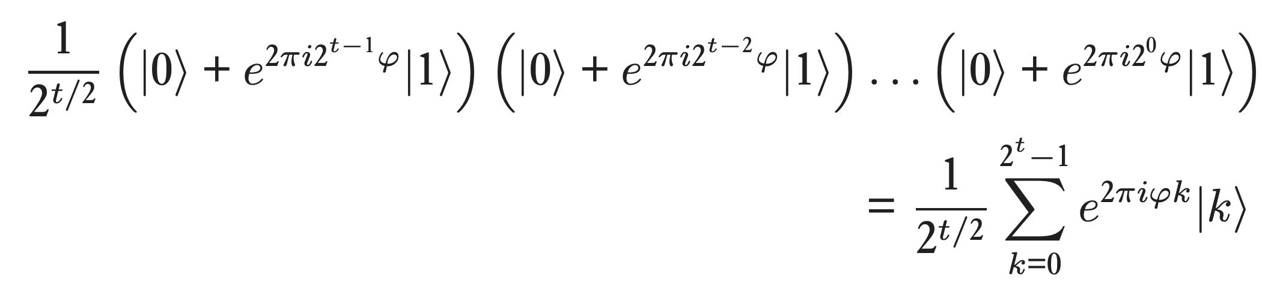
Recap: QPE– Oracle based controlled rotation step
This looks familiar?

Slide 5
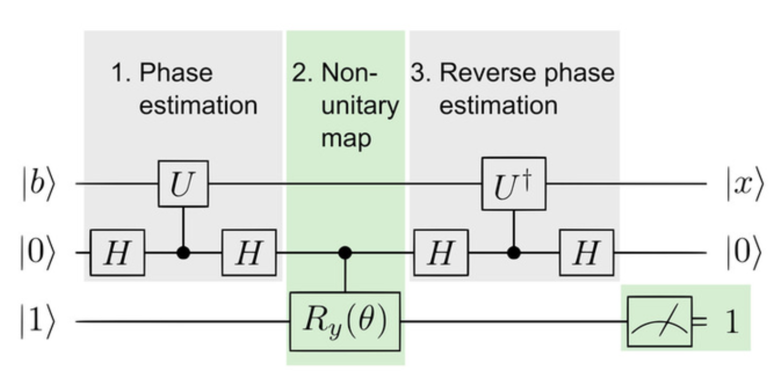
Recap: QLSA

Slide 6
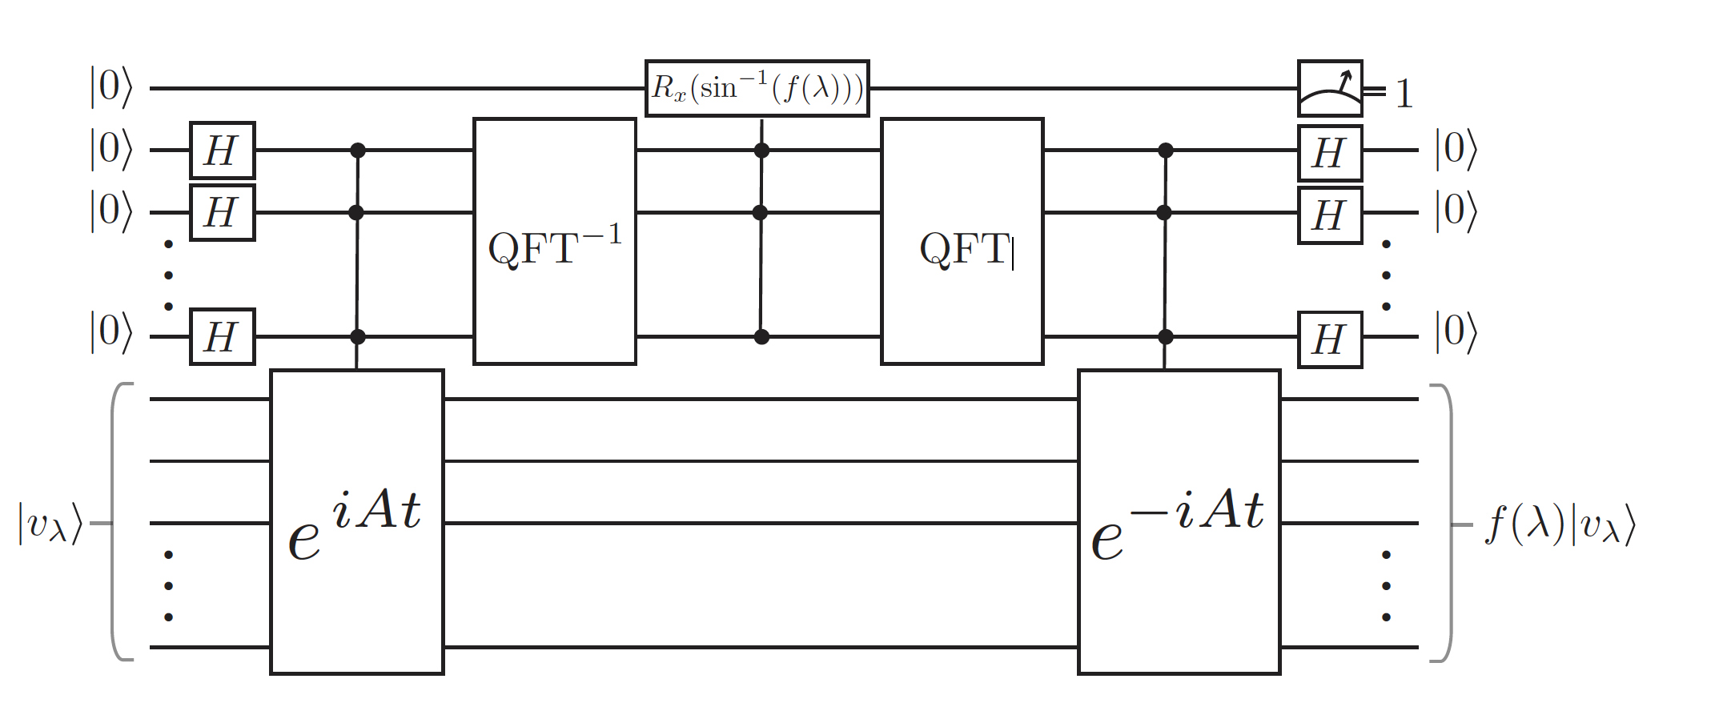
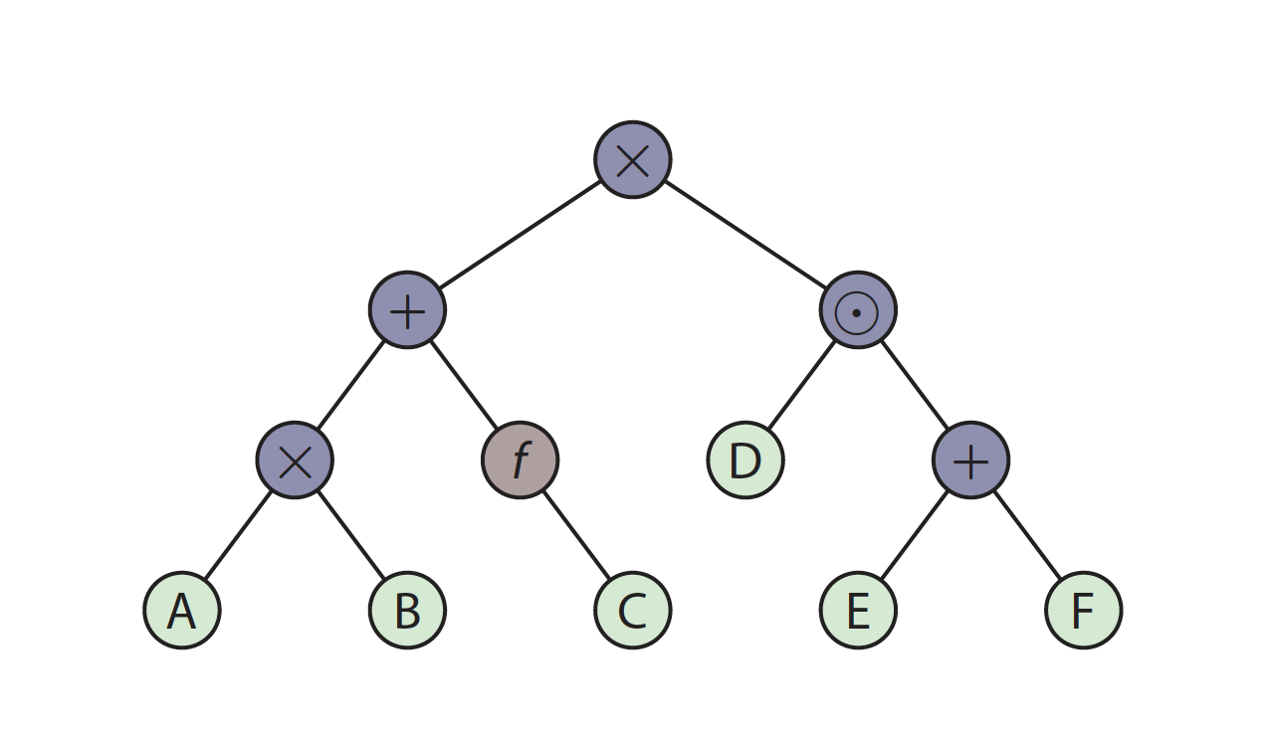
Recap: Fast Quantum Linear Algebra

Slide 7
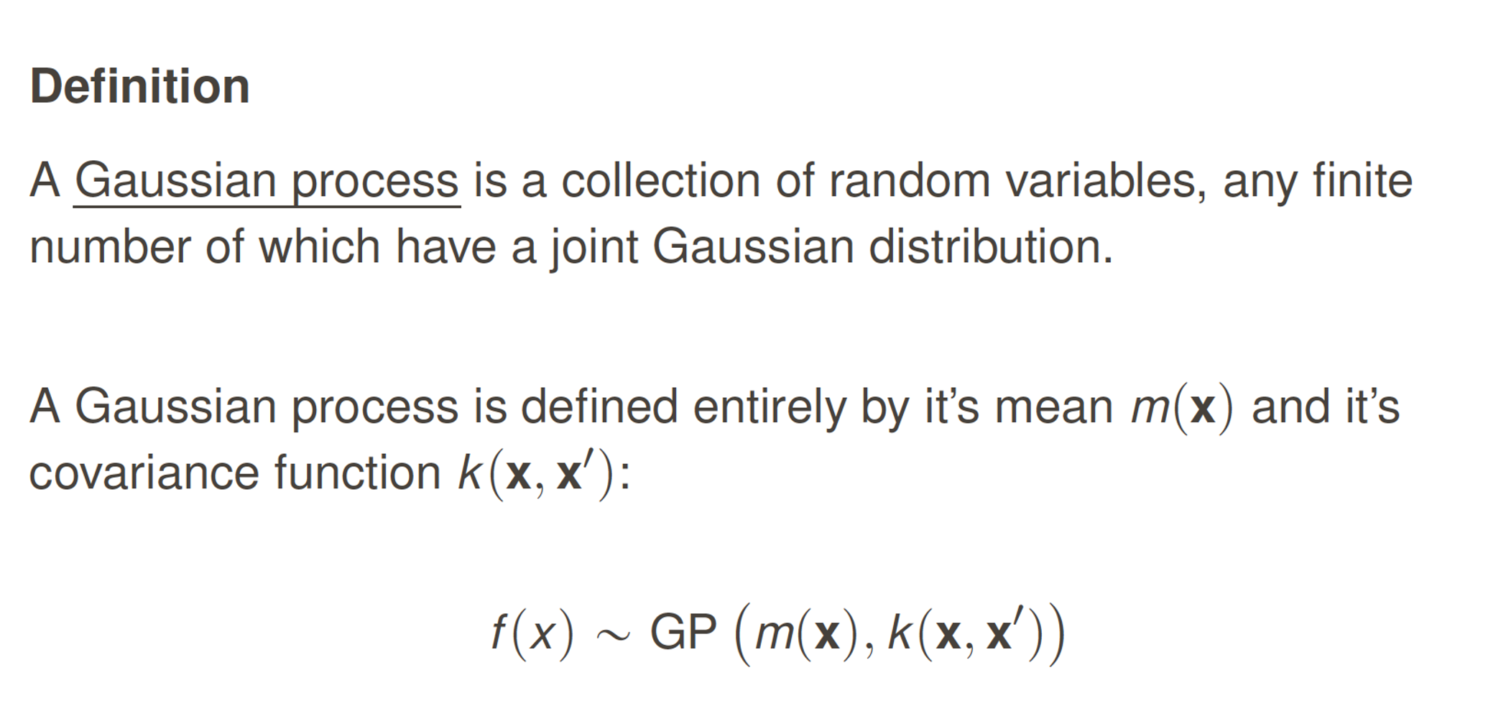

Slide 8
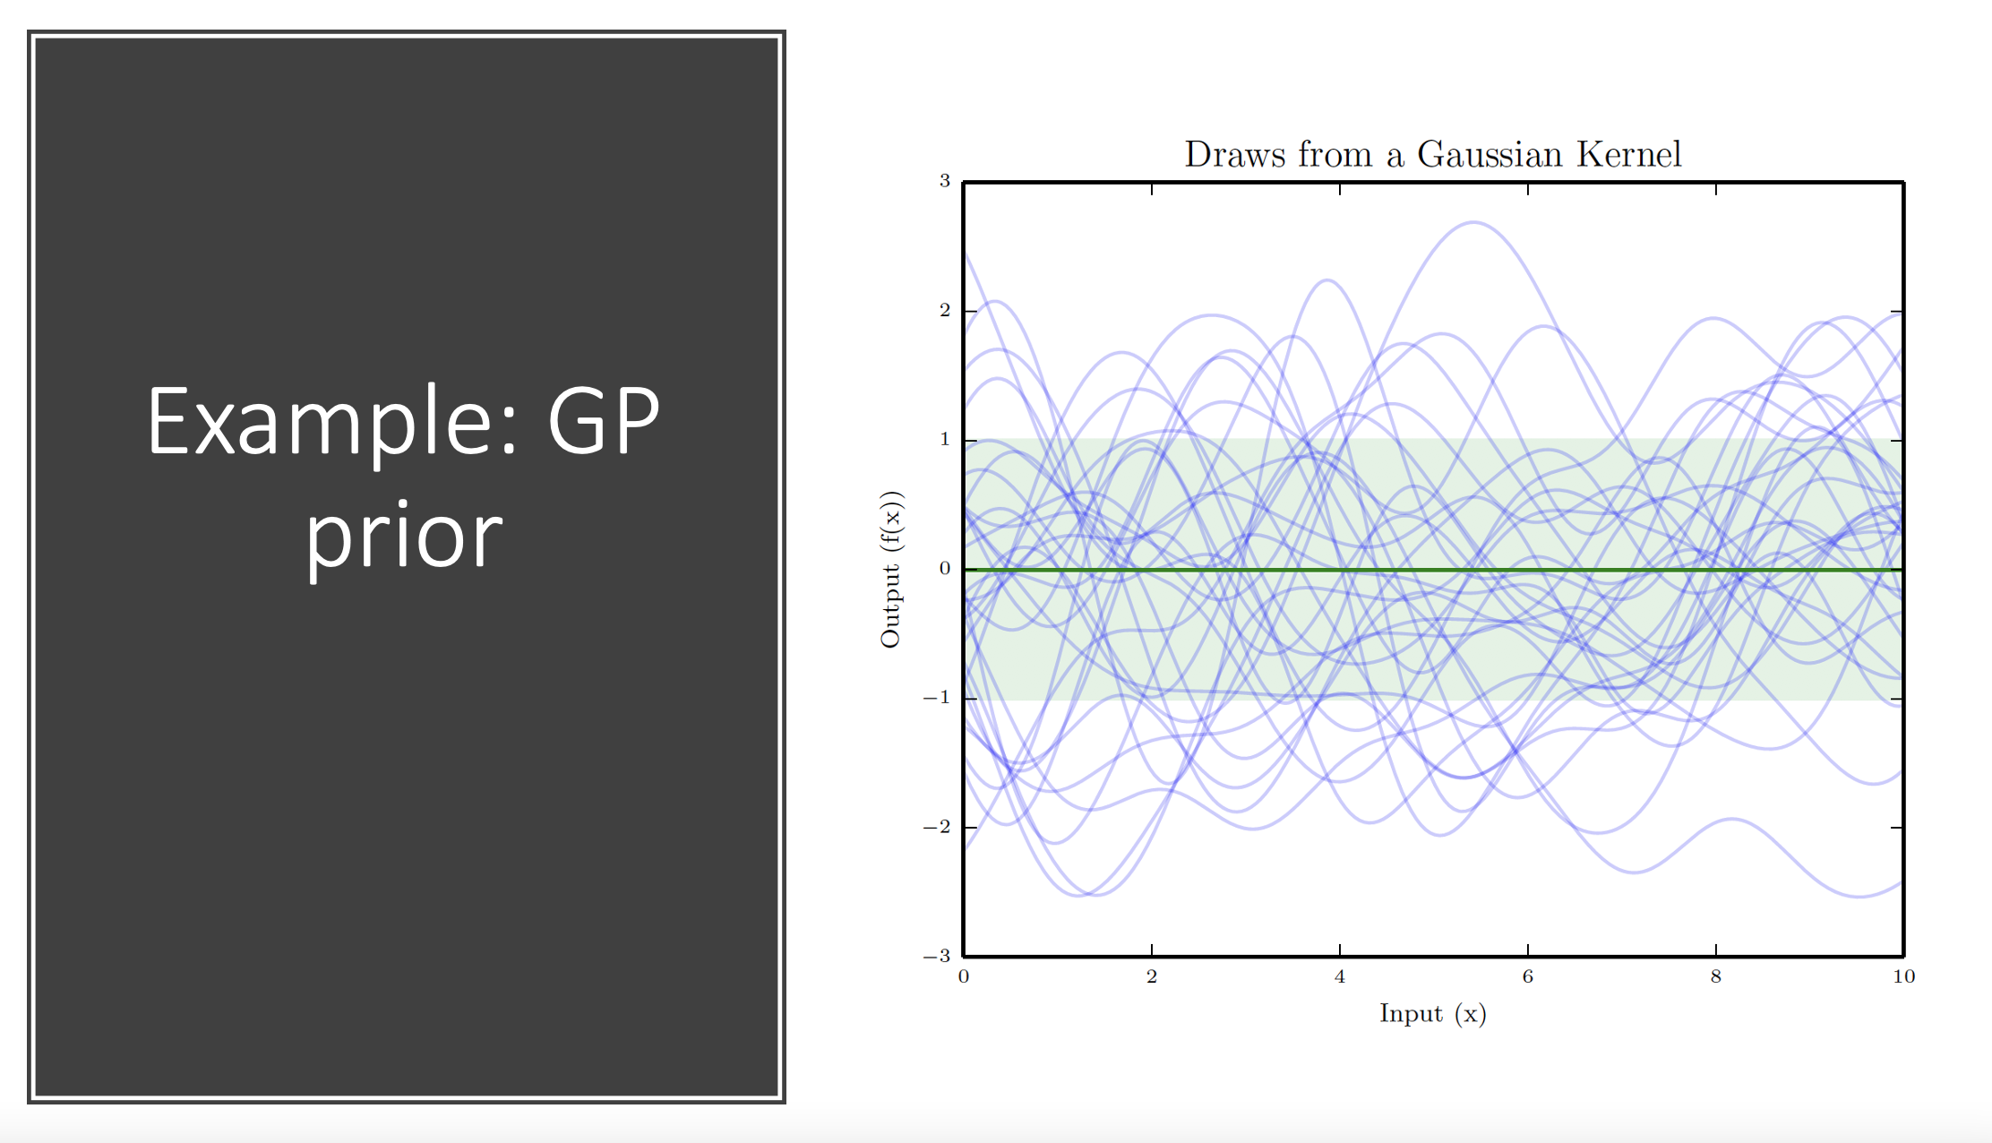

Slide 9
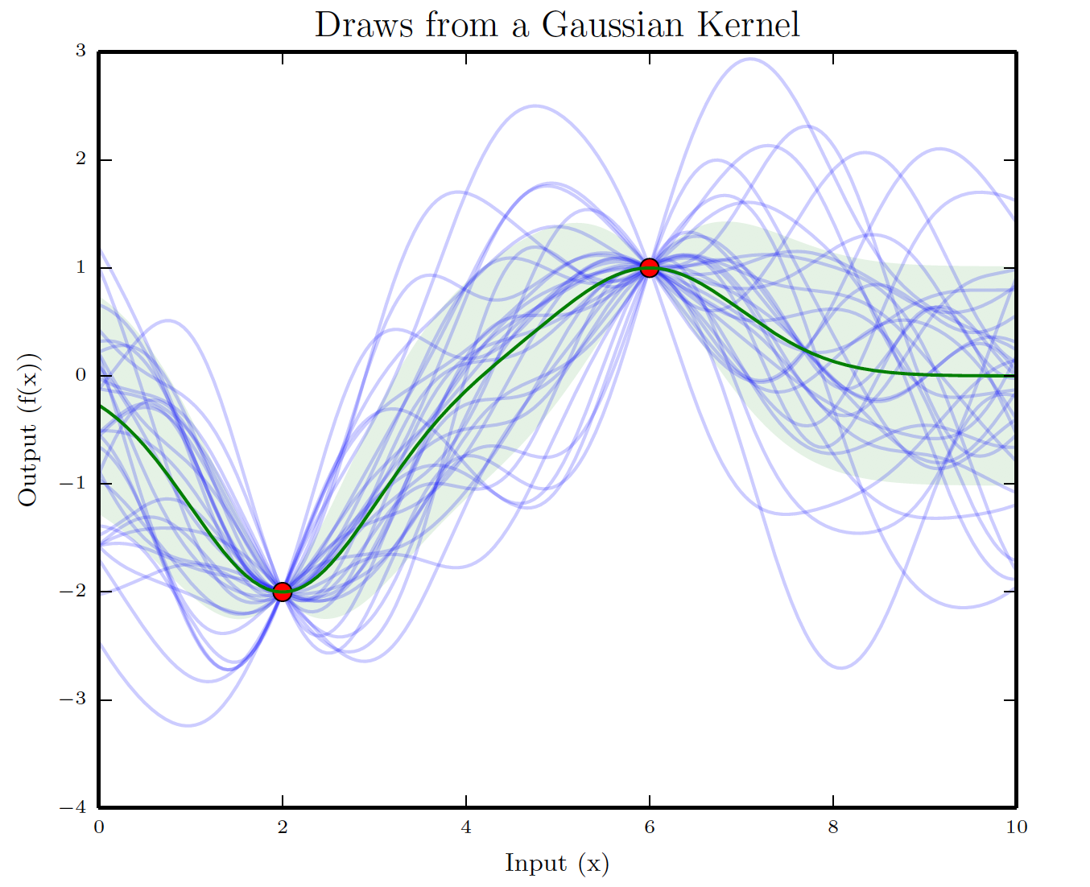
Example: GP Posterior

Slide 10
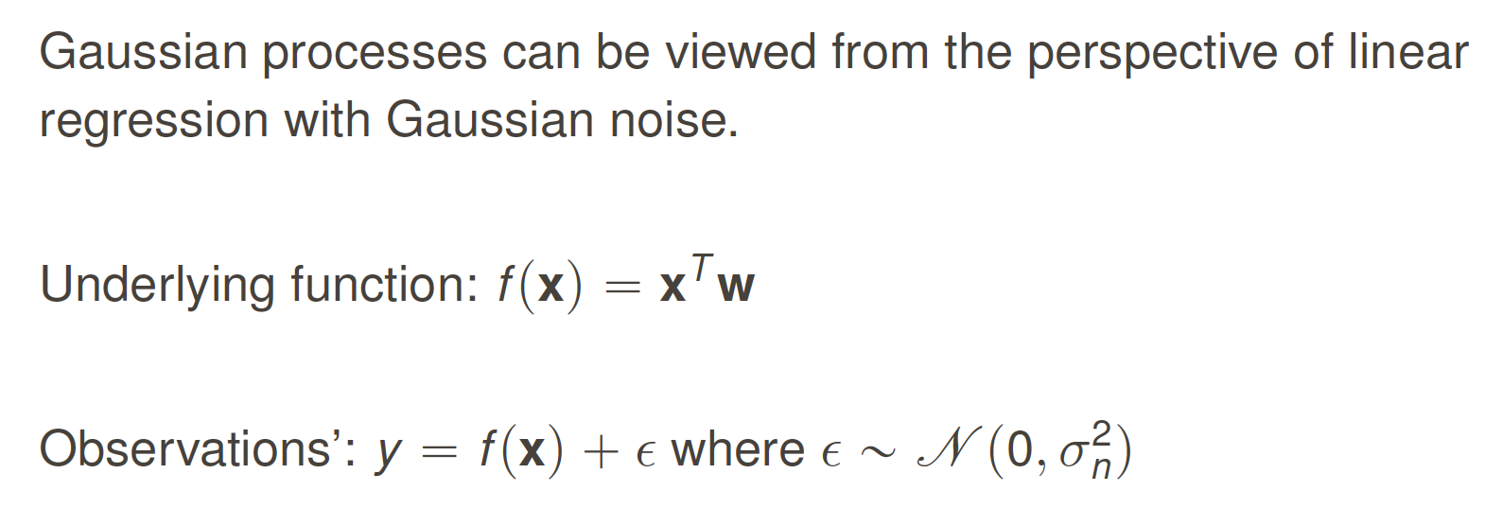
GP from linear regression

Slide 11
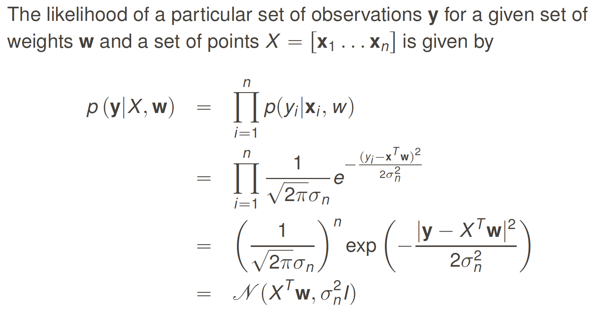

Slide 12
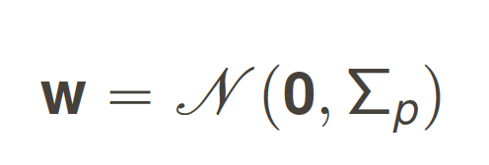
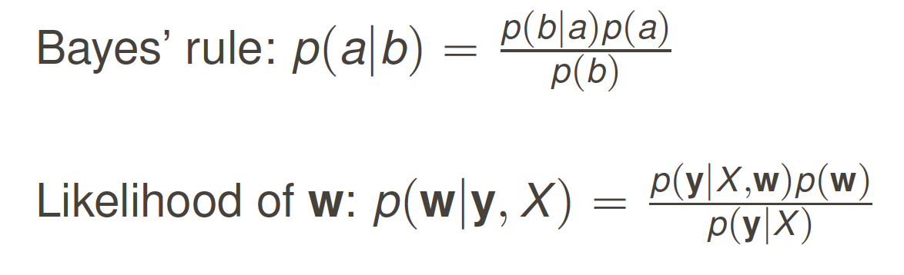
Bayesian Analysis
Assume a prior distribution over w:

Slide 13
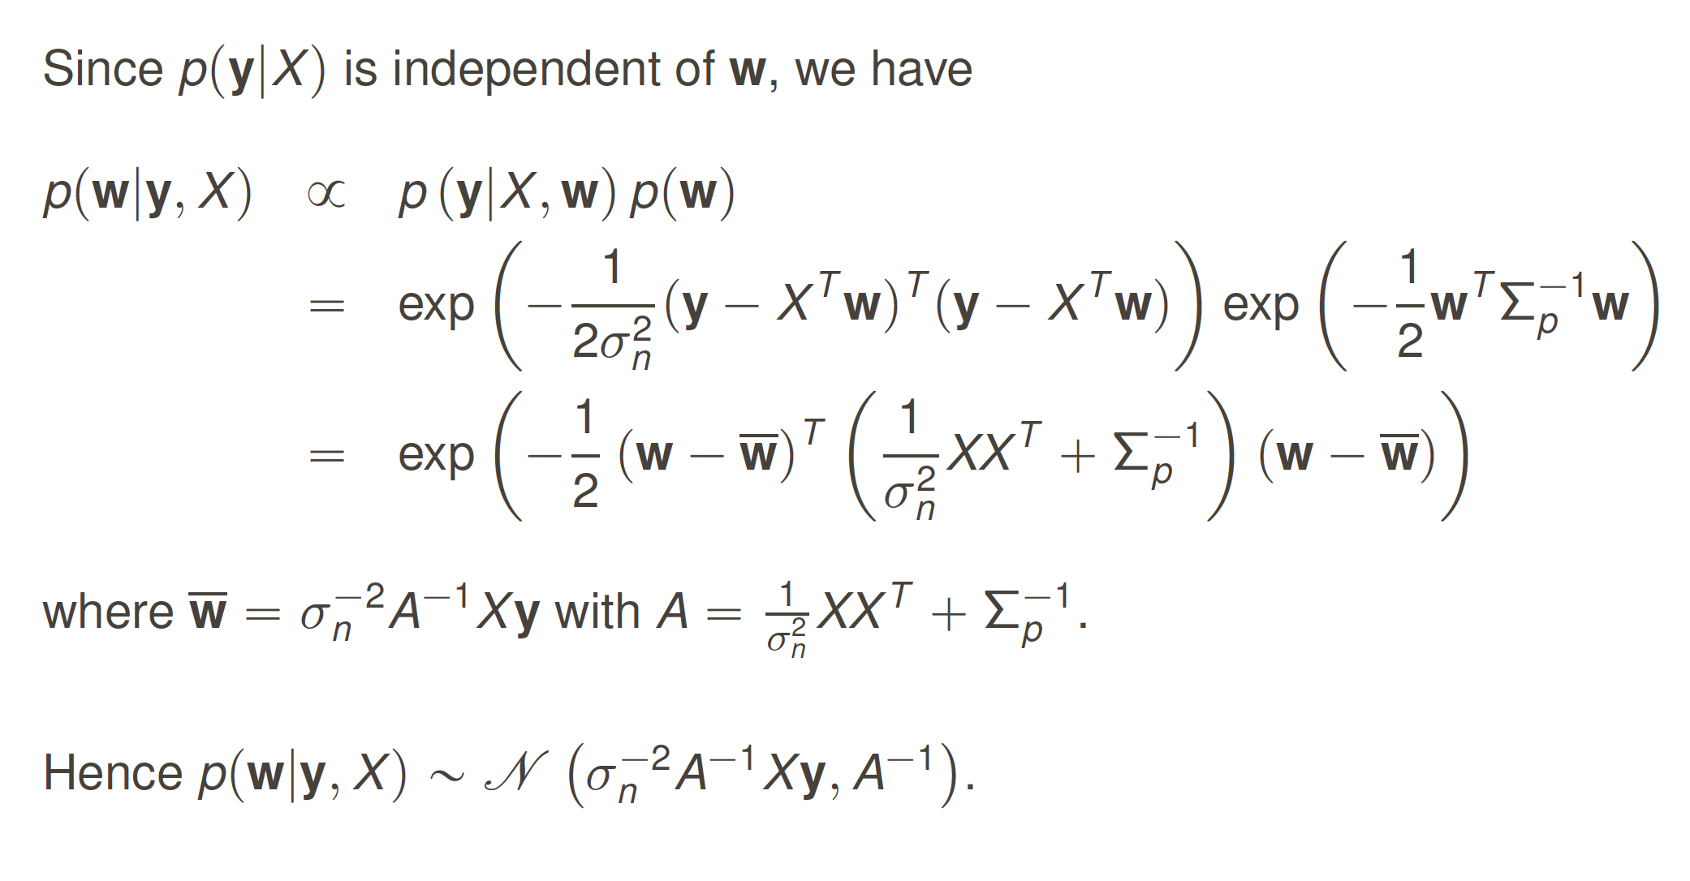

Slide 14
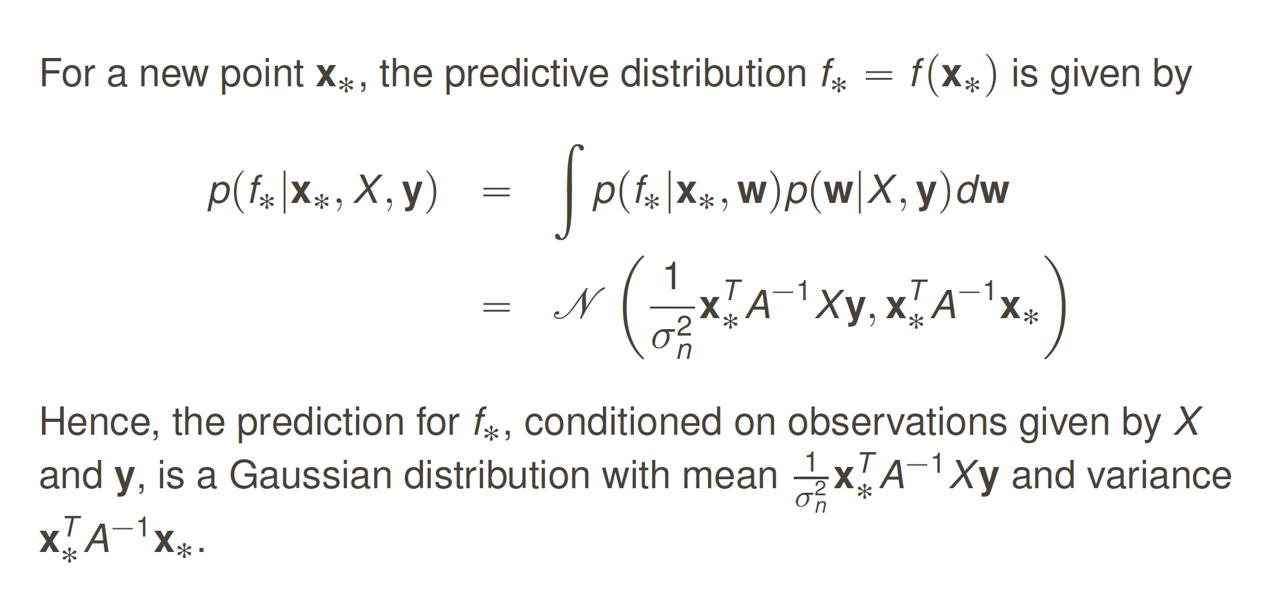
Predictions making

Slide 15
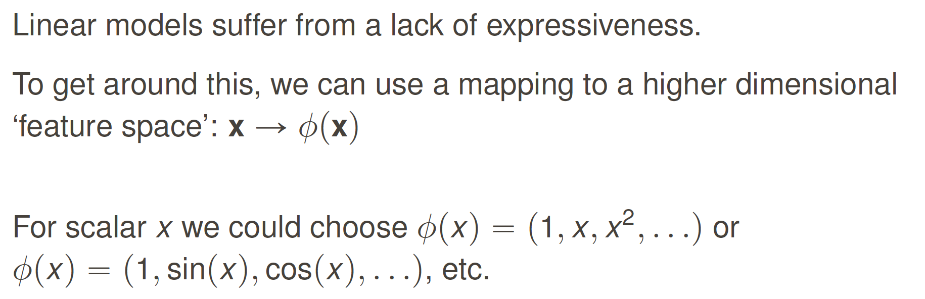
Feature Space

Slide 16
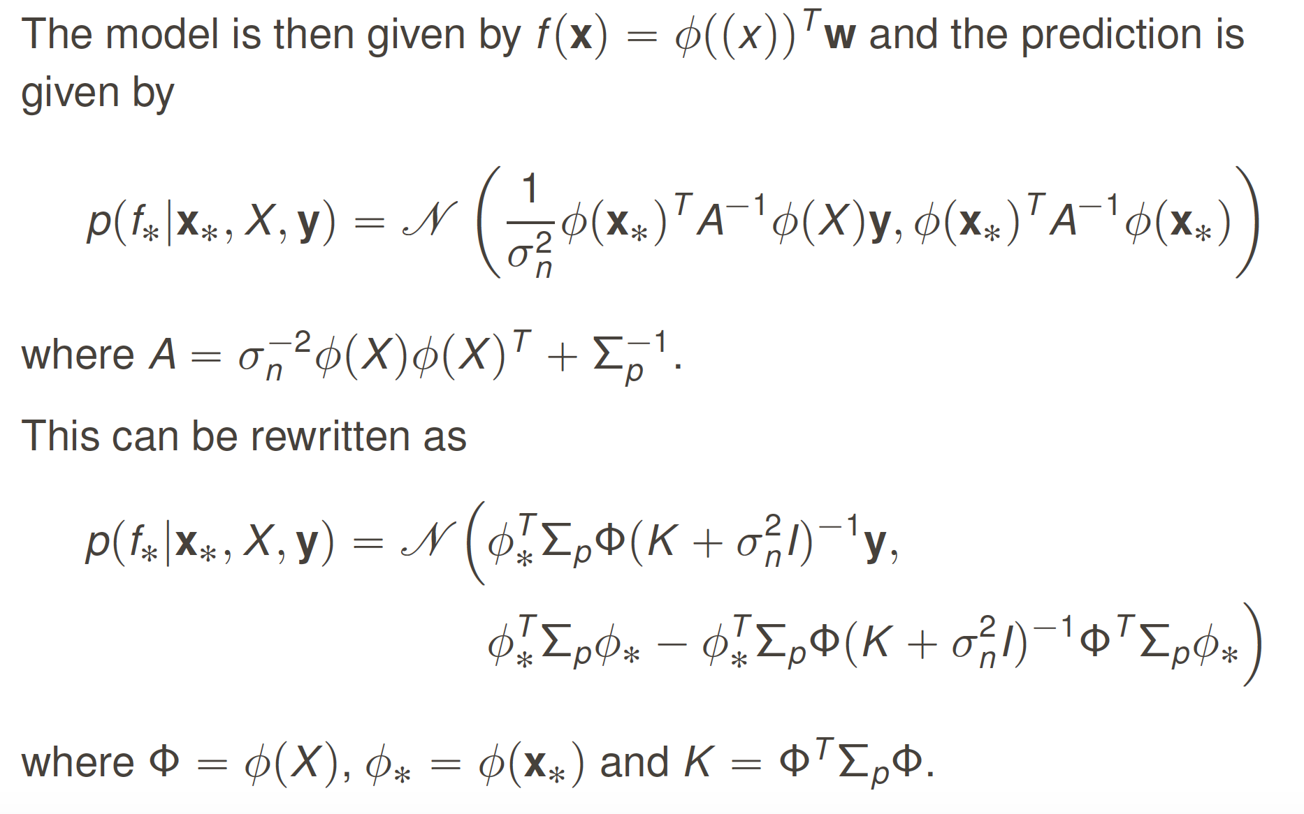

Slide 17
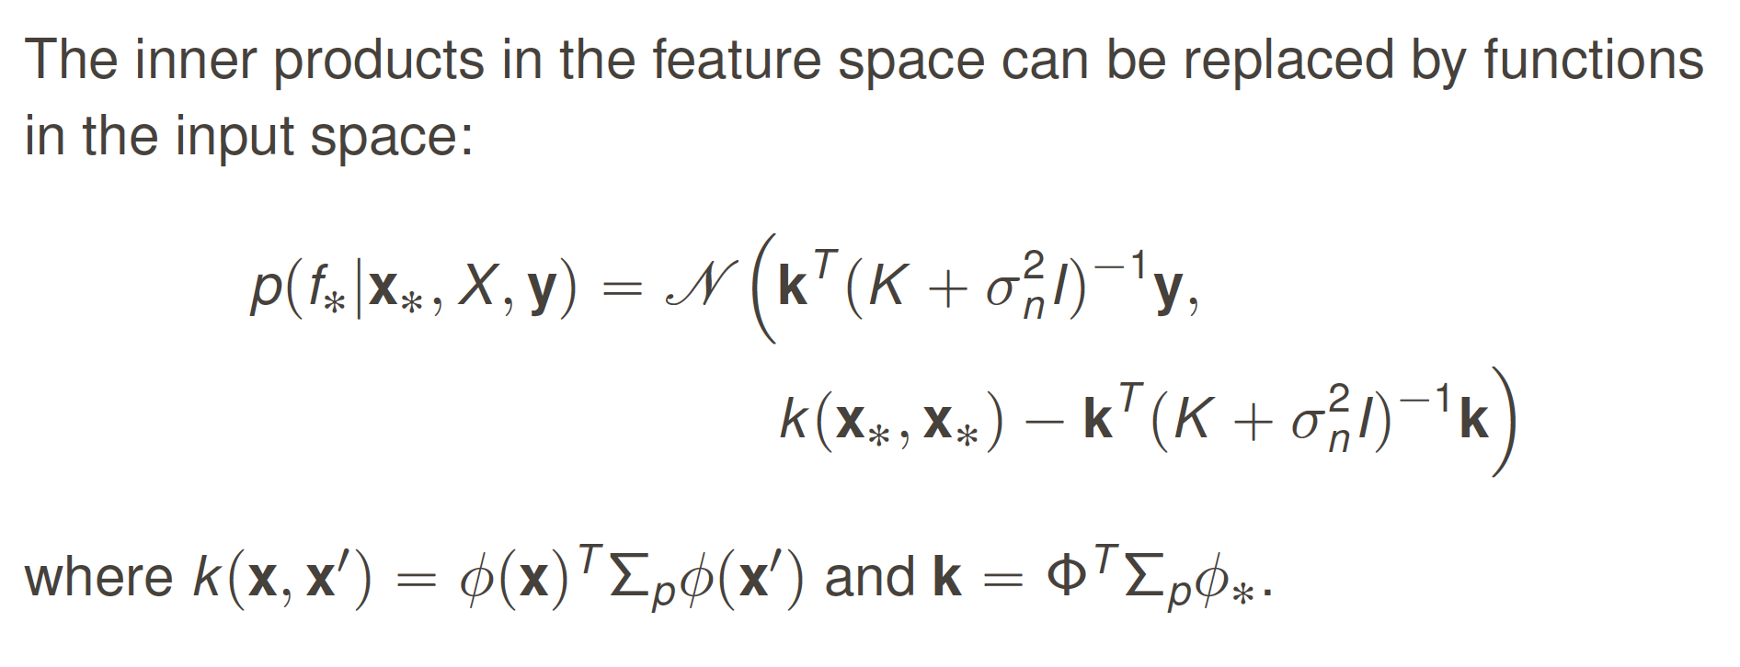
Kernel trick

Slide 18
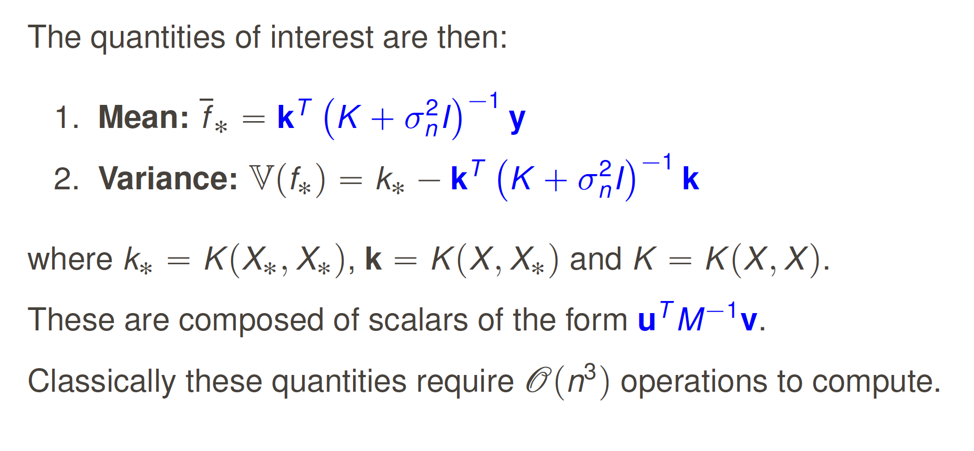
Objective of computation

Slide 19

Part 2:Quantum algorithms for GP regression and training
arXiv:1512.03929
arXiv:1803.10520

Slide 20
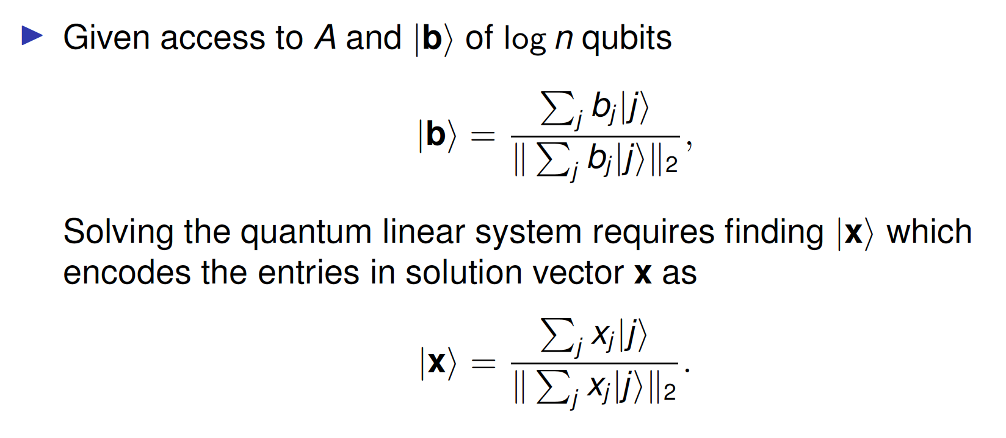
Quantum linear system algorithm (HHL)

Slide 21
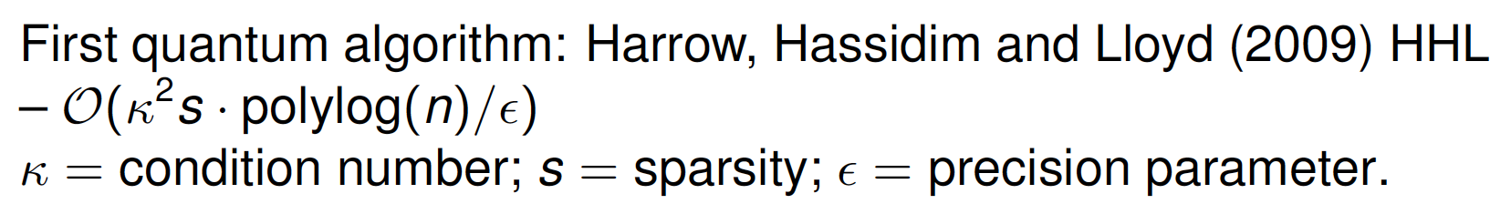
Potential catches:
State preparation
Solution readout
Sparsity dependence
Conditioning

Slide 22
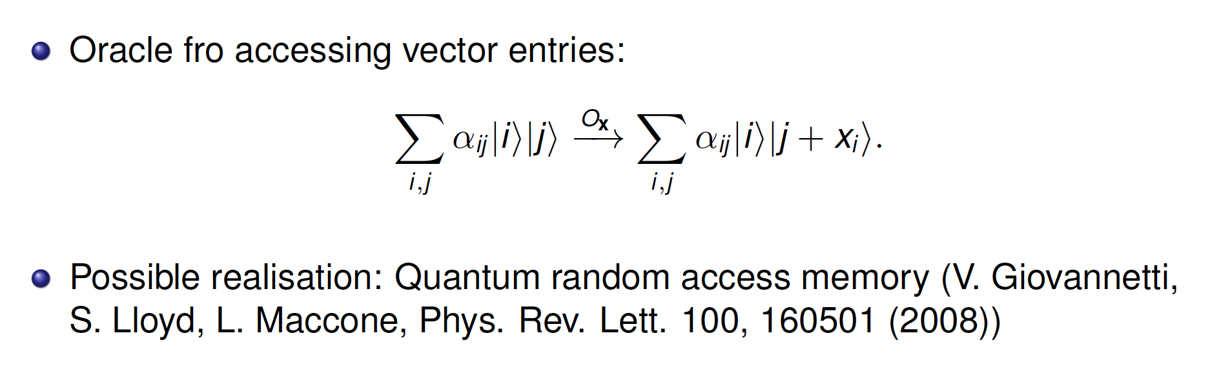
State preparation

Slide 23
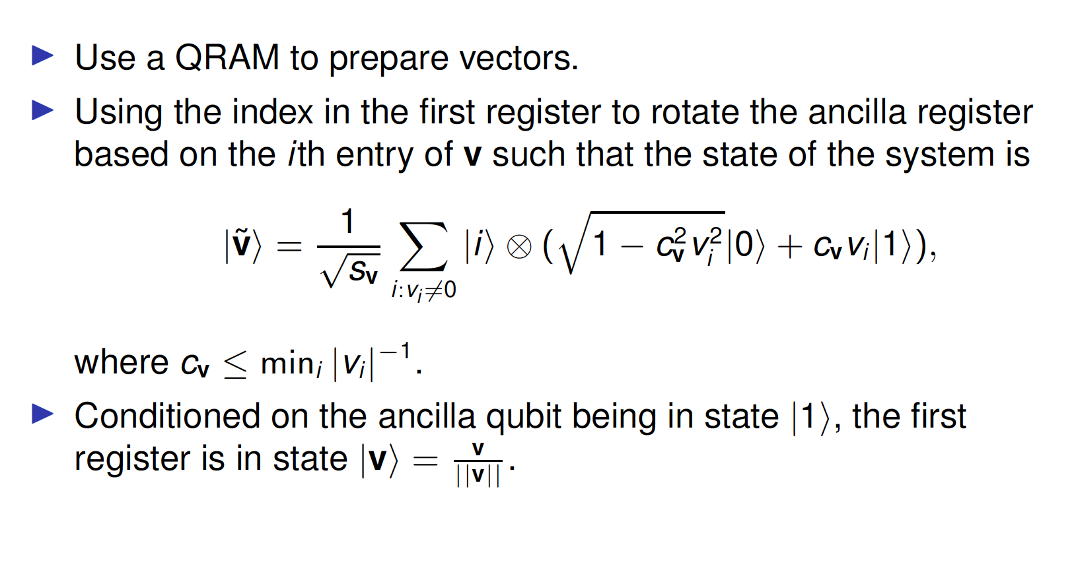
State preparation

Slide 24
Success probability:
Potential issue arise when we have extremely non-uniform input. i.e. A few entries are much larger than the rest.
Unordered search query lower bound:
This is very uncommon in datasets for where GPs are applied.
A more formal argument for efficient amplitude encoding is by looking at the smoothed complexity.

Slide 25
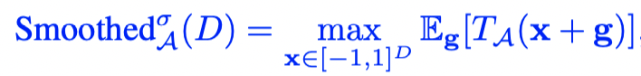
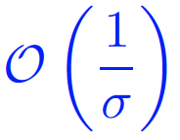
Smoothed complexity:
D. A. Spielman and S.-H. Teng, Communications of the ACM52, 76 (2009).
Intuition: A metric that interpolates between the performance of an algorithm on the random and worst-case datasets.
Originally to explain the efficiency of simplex algorithms, then generalized to a broader domain.
Smoothed complexity for oracle based state preparation:
(Updates in progress for arXiv:1804.00281)

Slide 26
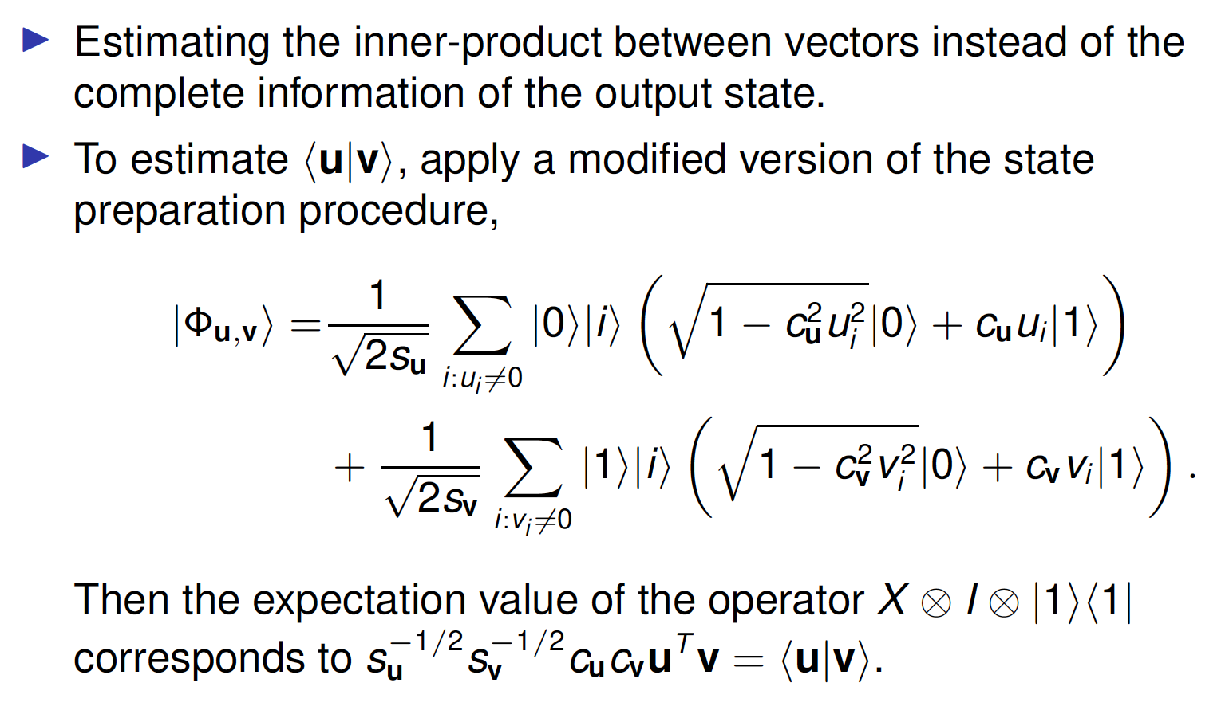
Solution readout

Slide 27
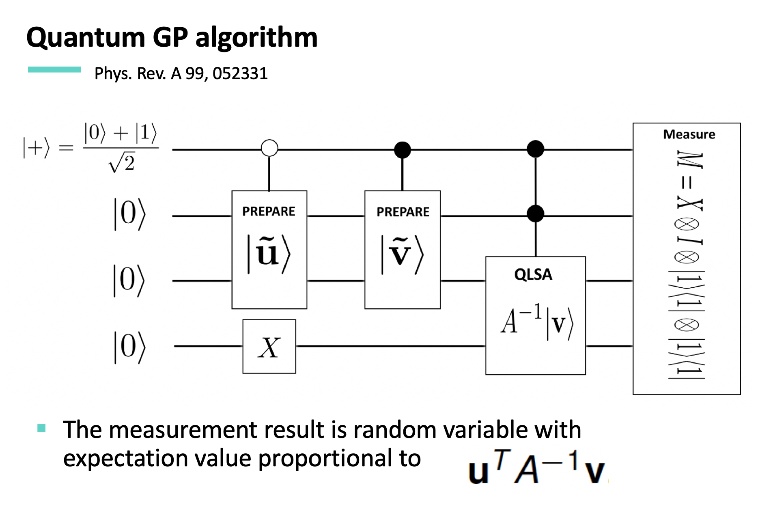

Slide 28
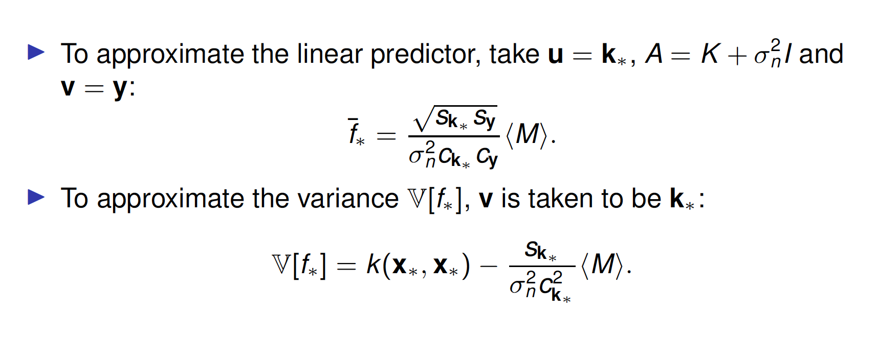

Slide 29
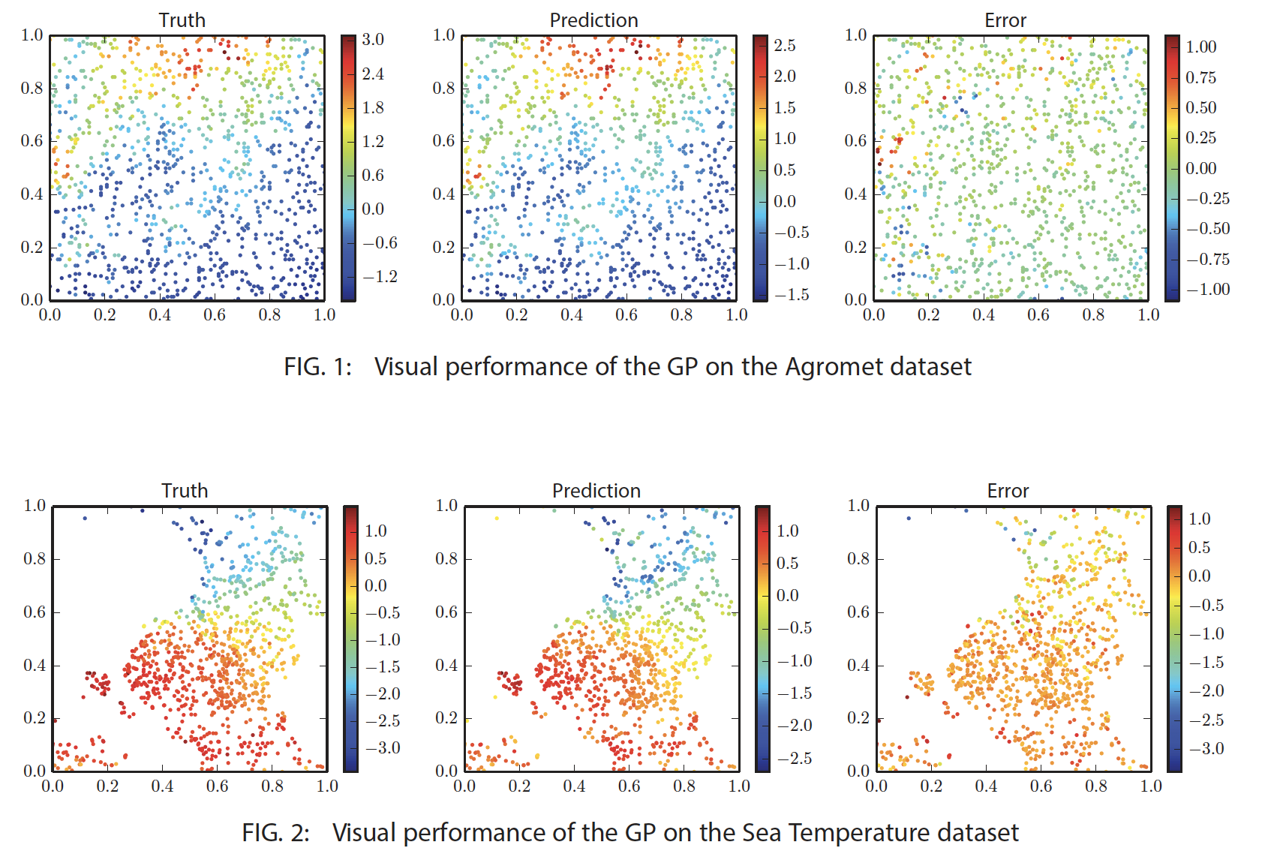
Sparsely constructed matrix
Use covariance tapering to represent localized covariance.

Slide 30
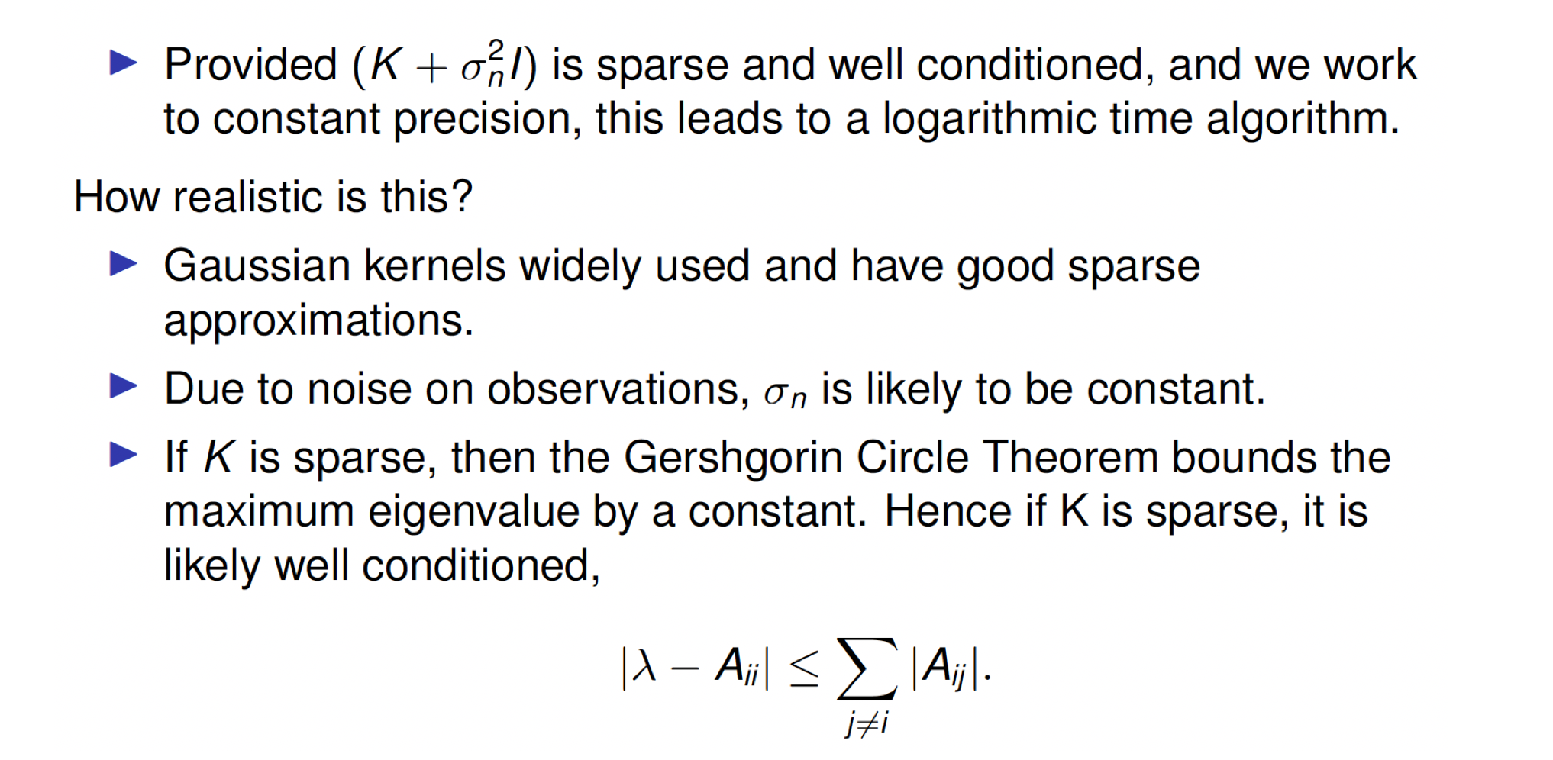
Quantum GP algorithm: Caveats examination
Application in material science: “Sparse quantum Gaussian processes to counter the curse of dimensionality” Quantum Machine Intelligence volume 3, Article number: 6 (2021)

Slide 31

To be continued…
Quantum enhanced GP for Bayesian deep learning
More on state preparation
Further remarks on nuances in applying QML

